Slide 1
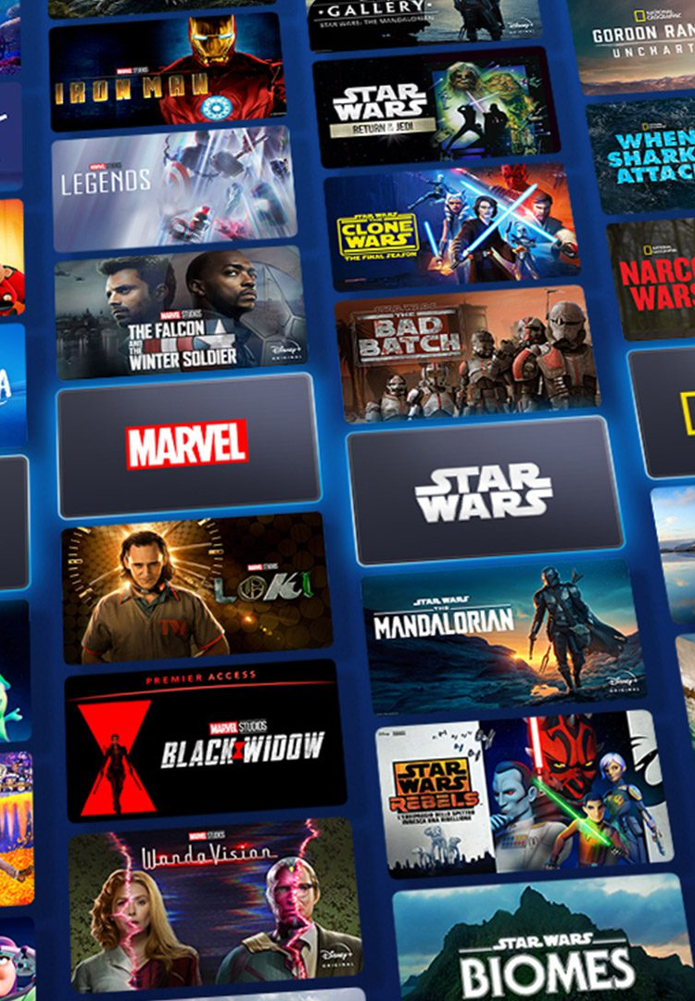

Recommendation System for Disney+ Shows and Movies
WQD7001 Principle of Data Science
Group 11
Name | Matric ID | Role
Nasir Uddin Ahmed | S2015449 | Leader, Detective
Muhammad Shahzad Rafiq | S2150889 | Maker
Qixiang Yin | S2150692 | Oracle
Low Boon Kiat | 17138399 | Presenter

Slide 2
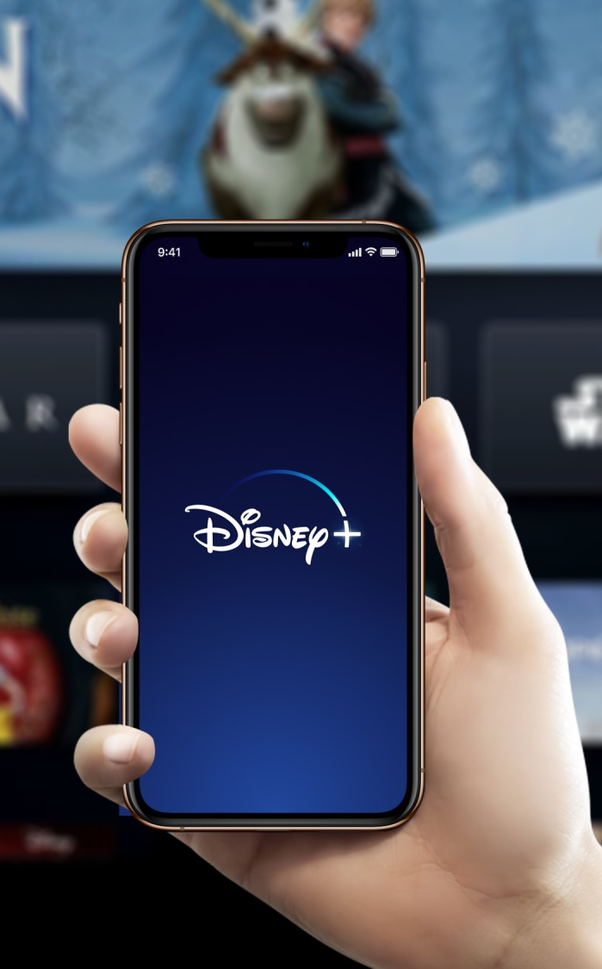
Table of Content
01
Executive Summary (from the Proposal)
05
Plan for Reproducible Research
02
Mechanics – Hardware, Software & Platform Used
06
Deployment
03
Methodology – Design & Development
07
Future Work & Conclusion
04
Experiment & Results
08
Reference & Appendixes

Slide 3
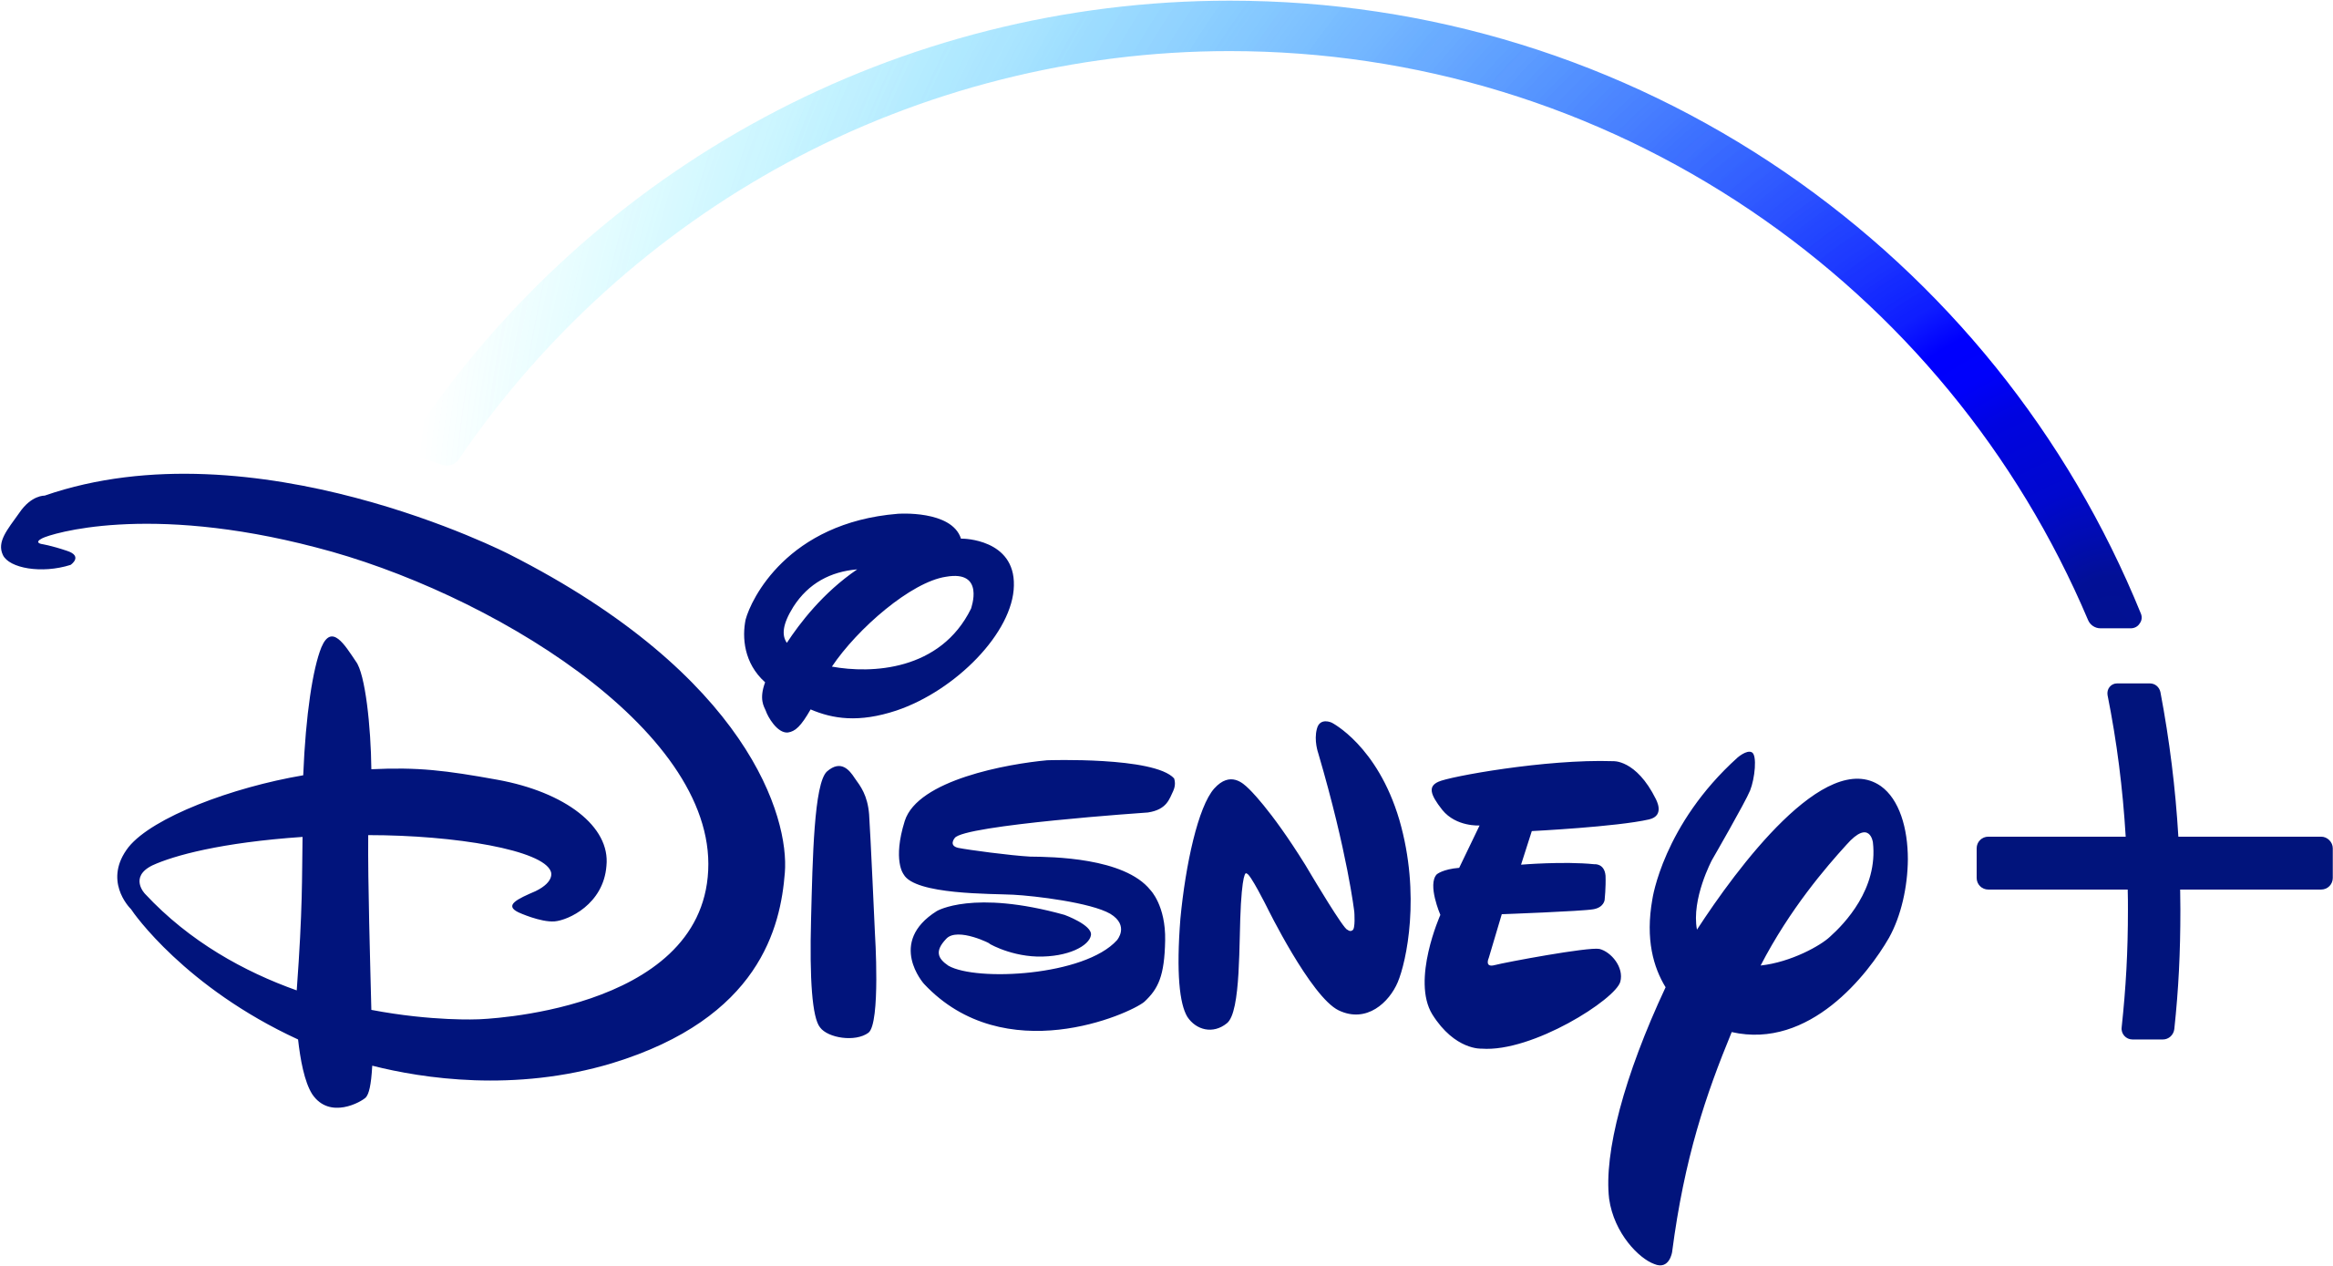

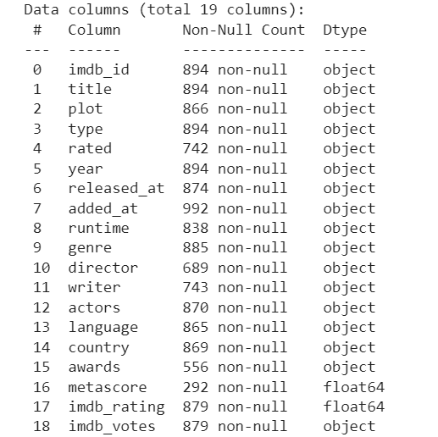
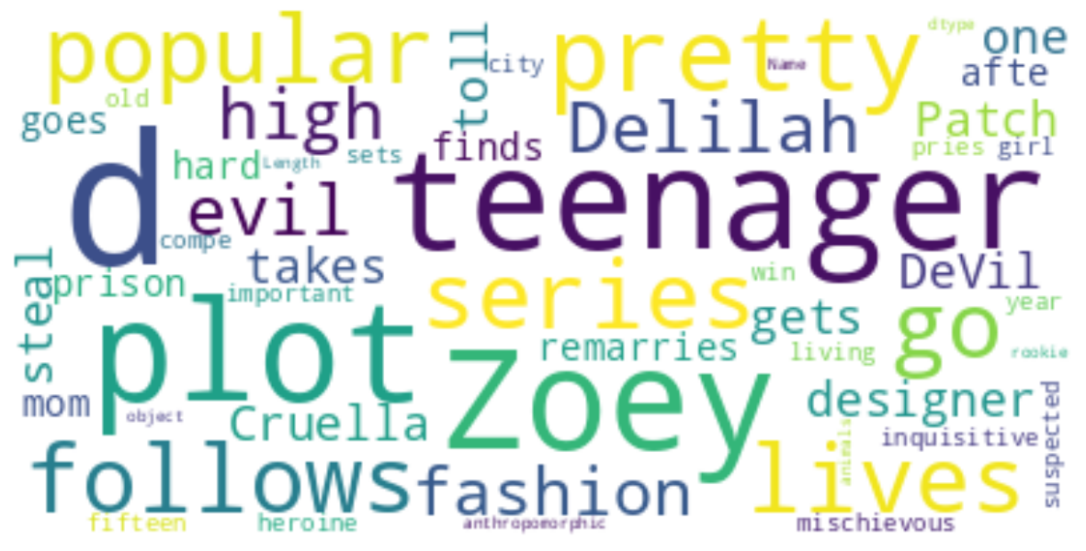
Executive Summary (from the Proposal)
Problem Statement
Project Goal
Launched in Nov 2019.
Popular, classic content on the streaming platform e.g. Disney, Marvel, Star Wars.
Growing fast. 160 million subscribers worldwide.
We tend to get overwhelmed quickly and make poor choices when presented with many options.
This theory also applies to streaming media where users are presented with thousands of video content.
To build a recommendation system which can help users to choose Disney+ video content.
Project Scope & Domain
Collaborator/End User
Exploratory Data Analysis (EDA)
End user will be a streaming media user who currently subscribes to Disney+.
He or she will give us feedbacks after using our data product.
Uncover data patterns through descriptive statistics and visual analysis.
For example, word cloud visually depicts the frequency of words in a given text, in this case, the titles of Disney Plus content.
Domain
Streaming media industry
Building a recommendation system to help users choose Disney+ video content
Dataset
Scope
Obtain from Kaggle
17 categorical variables
2 numerical variables
918 observations
Understand each variable and perform data cleaning

Slide 4






Mechanics – Hardware, Software, Platform Used
Hardware
Software
Platform
Minimum hardware requirement for Python.
Operating system: Windows 7, Mac OS X 10.11
CPU Architecture: Intel Core i3 or AMD Ryzen 3250u (64-bit)
1GB RAM, 2GB hard-disk space
The programming language used in this project is Python.
Python is chosen due to our familiarity with the tool and its vast amount of useful library.
Python has simplified syntax. Easy to use and learn by beginners.
Use Google Colab to run Python. Cloud-based platform useful for collaboration.
Use Shiny to create interactive web application.
Use GitHub for version control to ensure reproducible research.
Notes:
What Are the Ideal Computer specs for Python programming - Developers Resources (ssiddique.info)

Slide 5
Methodology – Design & Development
Define Problem & Goals
Data Procurement
Data Understanding
Data Preparation
Human makes poor choices when presented with many options.
Project goal is to build a recommendation system to help users to choose Disney+ content.
Obtain dataset from Kaggle.
Dataset released in 2020.
Contains 992 observations and 19 attributes.
Understand every attribute such as metascore, IMDb rating, IMDb votes, etc.
17 categorical variables; 2 numerical variables.
Check if there is any missing values, duplicate entries and outliers.
Results and Discussion
Modeling
Exploratory Data Analysis
Data Cleaning
Communicate our findings and recommendations to the stakeholders.
Apply 9 machine learning models to build recommendation systems.
Evaluate and compare model performance.
Descriptive statistics.
Visual analysis includes correlation heatmap, histogram, word cloud, boxplot, tree map, etc.
Impute missing values.
Remove duplicate entries.
Apply winsorization technique to replace outliers.

Slide 6
Experiment & Results (1/3)
Explored various recommendation techniques and evaluate each model performance.
Content-Based Filtering
Result:
For content-based recommender, it is difficult to measure accuracy and precision because user rating is not available in our dataset.
Leveraged textual features i.e. titles, descriptions, genres, and cast.
Performed Bag of Words Technique. Creating a concatenation of metadata representation that captures important information about the movie, including the actors, genre, and plot.
Count Vectorizer counts the occurrences of each word and creates a numerical representation of the text data. Calculate cosine similarity to measure similarity between items.
Make recommendation based on similar content.

Slide 7
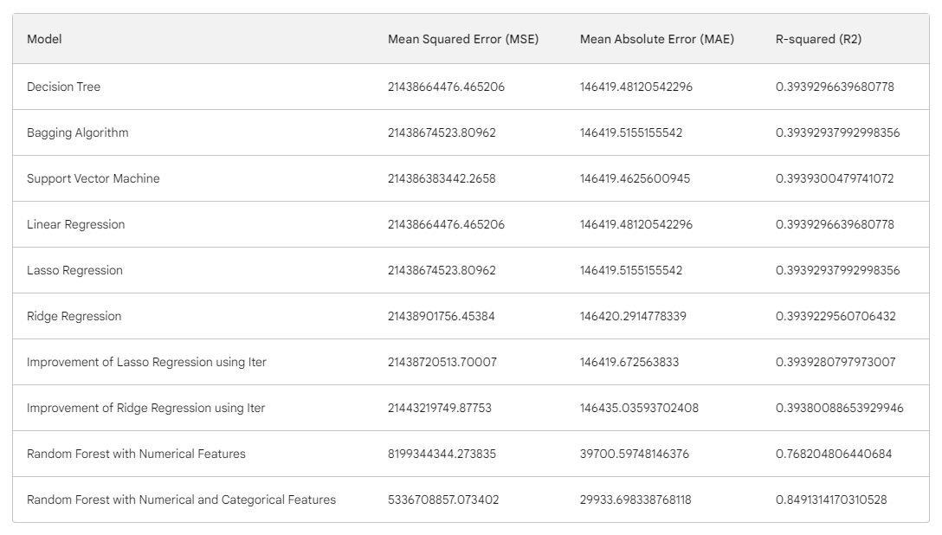
Experiment & Results (2/3)
Explored various recommendation techniques and evaluate each model performance.
Conventional Machine Learning Algorithms
Employed various machine learning models:
Decision Tree
Bagging Algorithm
Support Vendor Machine
Random Forest
Linear Regression
Lasso Regression
Ridge Regression
Used IMDb rating, IMDb votes, cast and crew information as inputs
Result:
Random Forest Model with Numerical and Categorical Features performed the best. It has the lowest errors (MSE & MAE) and the highest R-squared value (0.849), indicating a better fit to the data and better predictive performance.
Performed cross-validation, train-test split and hyperparameter adjustment to reduce overfitting.

Slide 8
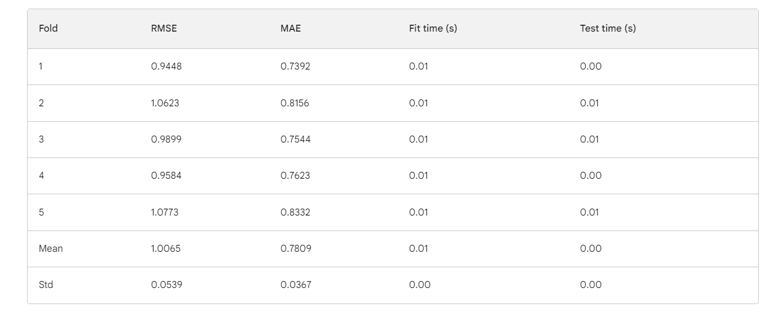
Experiment & Results (3/3)
Explored various recommendation techniques and evaluate each model performance.
Item-based Collaborative Filtering
Employed KNN (k-nearest neighbors) algorithm.
Performed cross-validation with 5 folds.
Result:
Overall results look promising. Mean RMSE and MAE are relatively good. There is still some variation between the folds. This suggests that the recommendation system is not yet fully converged. Suggest to use a larger dataset, and hybrid approach for further improvement.
Evaluate model performance using Root Mean Squared Error (RMSE) and Mean Absolute Error (MAE)

Slide 9

Plan for Reproducible Research
Version Control
Data Repository
Use Git to track changes to the code. This will make it easy to reproduce the results of the project at any point in time.
Store the data in a data repository, such as a Google Cloud Storage bucket or AWS . This will make it easy to share the data with others.
Code Documentation
Reproducibility Validation
Document the code with comments that explain what each part of the code does. This will make it easier for others to understand and modify the code.
Share the documentation, code, and dataset with others. Encourage others to replicate the research and provide feedback or suggestions for improvement.

Slide 10
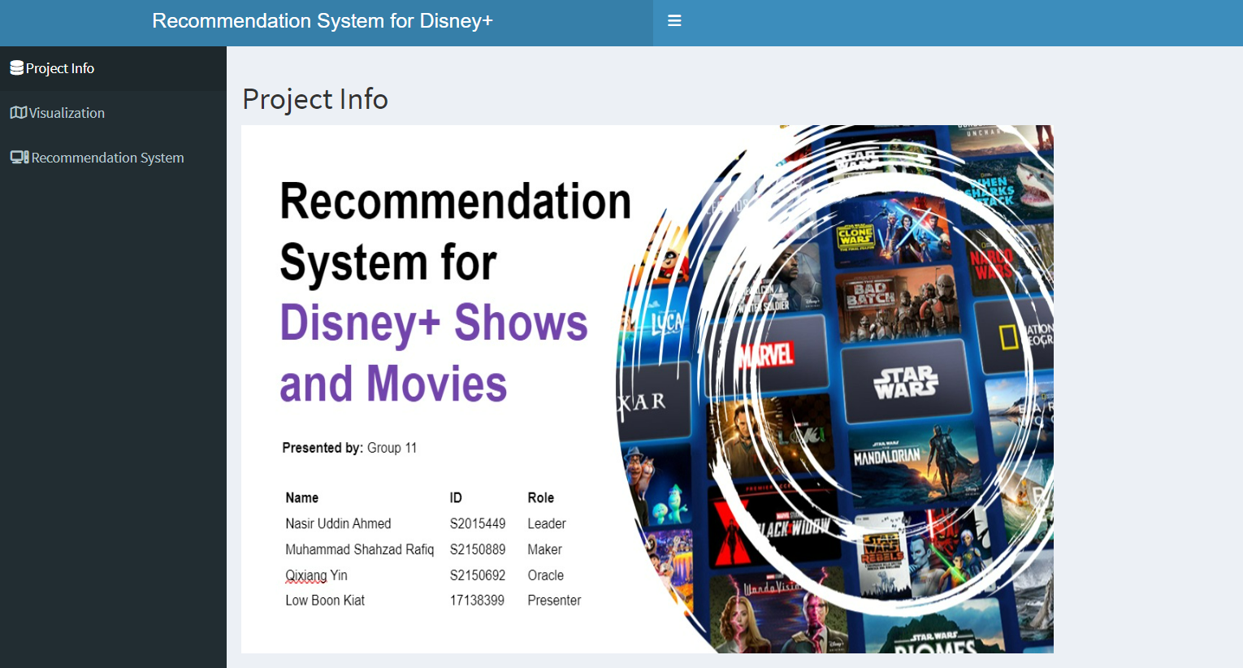
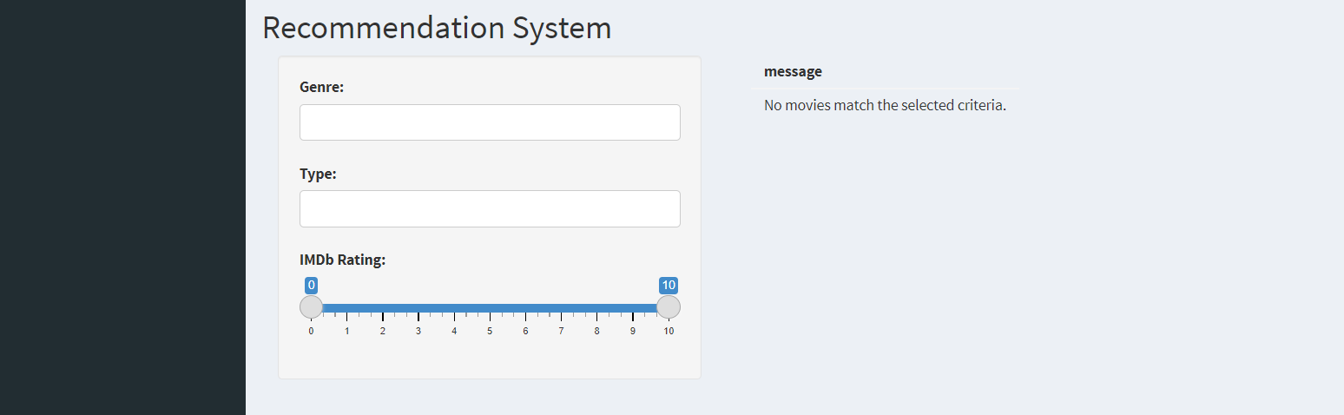
Deployment
Data Product
An interactive web application on Shiny which provides personalized recommendation for Disney+ shows and movies
Provided an intuitive user interface for users to explore personalized recommendations based on their preferences and interactions.
Require 3 inputs from users
Genre
Type
IMDb rating

Slide 11
End User Feedback
Feedback
Personalized Suggestions
Personalized suggestions on your data product may extend beyond individual preferences to include recommendations based on demographic information. This could include suggestions tailored for specific age groups, such as content suitable for children, teenagers, or adults.
Name:
Muhammad Imrul Bahar
Email Address:
imrulishu@gmail.com
Job Description:
Graphics Designer, Chorki (Bangladeshi subscription-based Streaming Platform.)
Recommendations from Multiple Disney Brands
Disney+ encompasses a vast library of content from various Disney-owned brands like Pixar, Marvel, Star Wars, and National Geographic. It can be considered in the future version of the data product.
New Releases and Exclusive Content
May be the recommendation system to highlight new releases based on user preferences and viewing habits.

Slide 12
Future Work & Conclusion
Upgrade the system using a larger dataset.
Using more sophisticated algorithms .
Automation of the system.
Applying hybrid approach.
Future
Plan
In this Disney+ recommendation system project, we tried to achieve accurate and high-quality content recommendations by effectively analyzing diverse movie features. Through capturing intricate relationships and extracting valuable insights on feature importance, the project delivered content recommendations, ultimately enriching the content discovery process for Disney+ users.
Conclusion

Slide 13
Reference & Appendices
Ahuja, R., Solanki, A., & Nayyar, A. (2019). Movie Recommender System Using K-Means Clustering AND K-Nearest Neighbor. 2019 9th International Conference on Cloud Computing, Data Science & Engineering (Confluence), 263–268. https://doi:10.1109/CONFLUENCE.2019.8776969
Awan, M. J., Khan, R. A., Nobanee, H., Yasin, A., Anwar, S. M., Naseem, U., & Singh, V. P. (2021). A Recommendation Engine for Predicting Movie Ratings Using a Big Data Approach. Electronics, 10(10), 1215. https://doi.org/10.3390/electronics10101215
Fortune Business Insights (2022) Video Streaming Market Size Forecast 2022-2029, Video Streaming Market Size, Share, Growth & Forecast [2029]. Available at: https://www.fortunebusinessinsights.com/video-streaming-market-103057 (Accessed: 08 May 2023).
Gomez-Uribe, C. A., & Hunt, N. (2015). The Netflix Recommender System. ACM Transactions on Management Information Systems, 6(4), 1–19. https://doi.org/10.1145/2843948
Richter, F. (2021) Infographic: Where Americans get their stream on, Statista Infographics. Available at: https://www.statista.com/chart/25382/most-used-video-streaming-platforms/ (Accessed: 08 May 2023).
Roy, D., & Dutta, M. (2022). A systematic review and research perspective on recommender systems. Journal of Big Data, 9(1), 59. https://doi:10.1186/s40537-022-00592-5
Schwartz, B. (2016) The paradox of choice why more is less. New York: Ecco.
Zhang, J., Wang, Y., Yuan, Z., & Jin, Q. (2020). Personalized real-time movie recommendation system: Practical prototype and evaluation. Tsinghua Science and Technology, 25(2), 180-191. https://doi:10.26599/TST.2018.9010118

